Slide 1
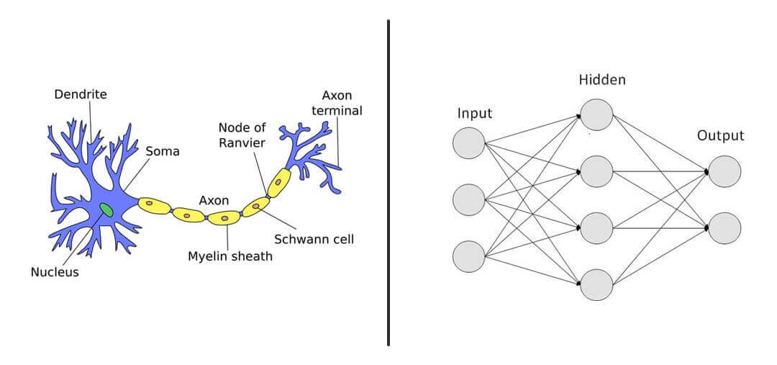
Neural Networks
Notes:
Source: https://www.youtube.com/watch?v=ZVR2Way4nwQ

Slide 2
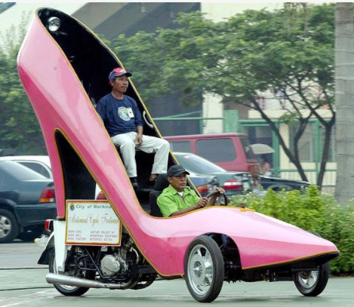
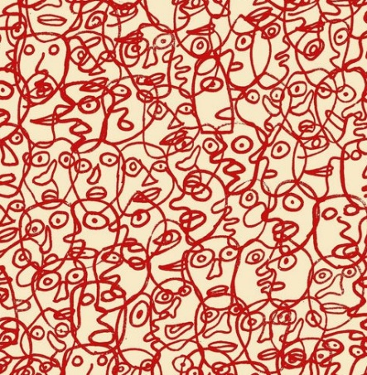
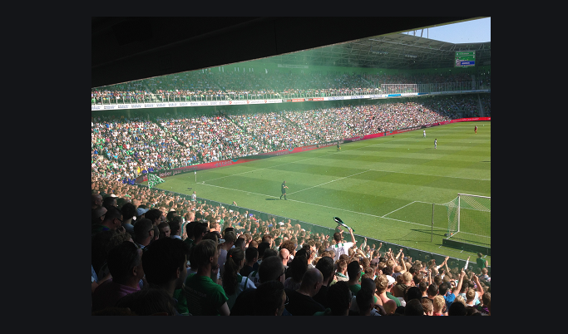

How do you recognize a face, a car, …?

Slide 3
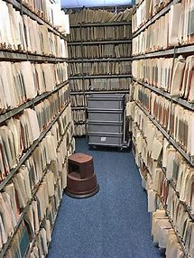
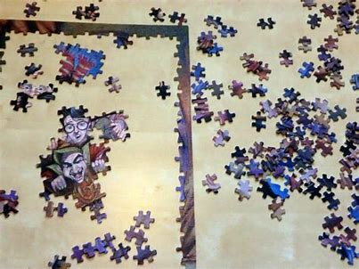
How do you recognize patterns?

Slide 4

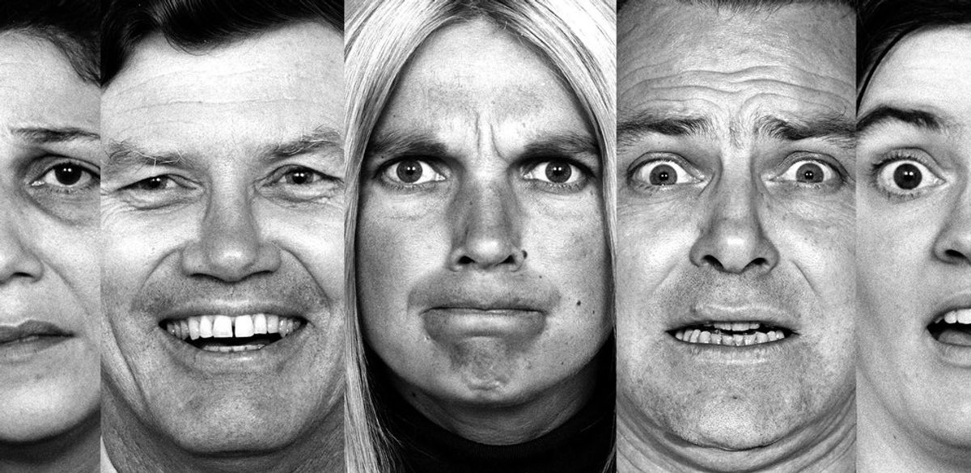

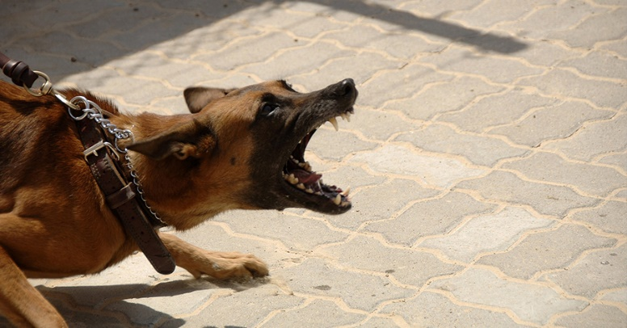
How do you recognize emotions?

Slide 5
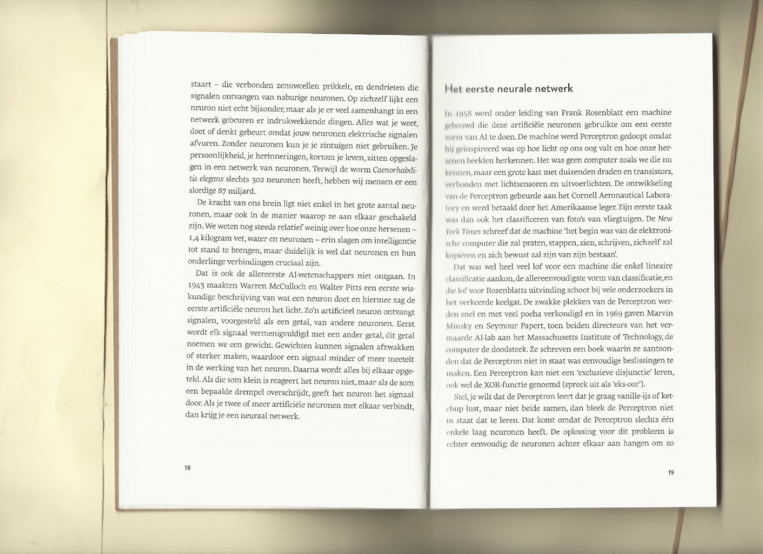
How do you understand the meaning of a text?
What does understanding actually mean?
Do all humans understand in the same way?

Slide 6
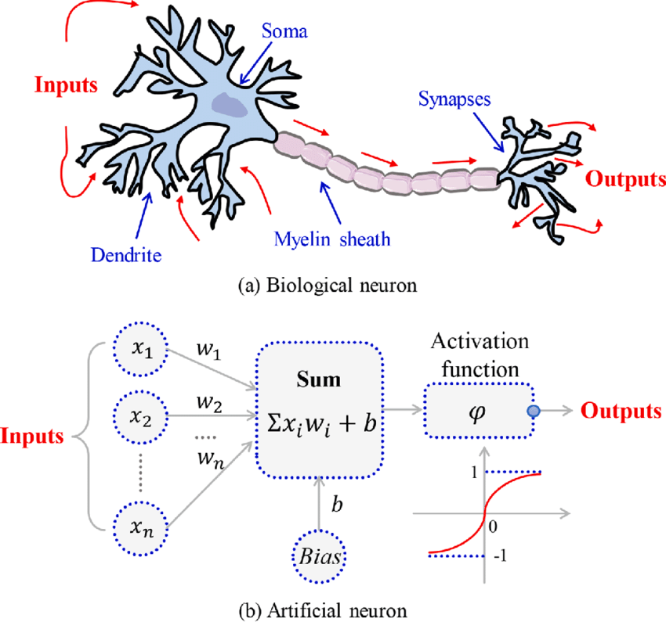
Neural networks ca 1943
The first version of a neural network was formulated by Warren McCulloch and Walter Pitts.
Based on biology and fysiology!
In 1949 Donald Hebb showed that these neural networks can learn by updating the connection strengths in a certain way (“cells that fire together wire together”)
First computer (SNARC) that simulated a neural network was built in 1950.
Built from 3000 vacuum tubes (transistors) and a left over auto-pilot of a B-24 bomber.
It could simulate 40 neurons.
But it worked and showed machines can learn!
Notes:
Hebbian theory (Hebb’s rule): defined the feed forward propagation, the weights will be adjust when performing a task over and over again. Neurons will be triggered by sufficient neighbours.
SNARC: had short term and long term memory to learn how to navigate through a virtual maze.
More information about neurons and mathematics: https://www.youtube.com/watch?v=osa3zIEJjgw

Slide 7
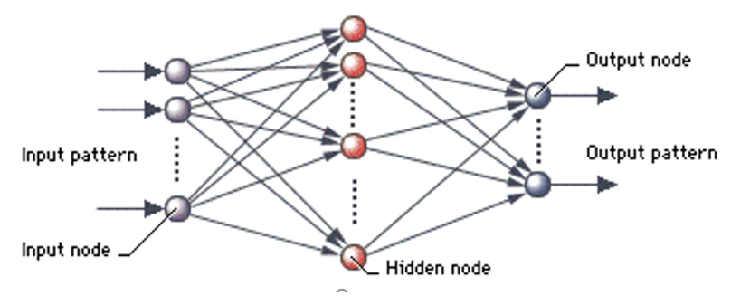
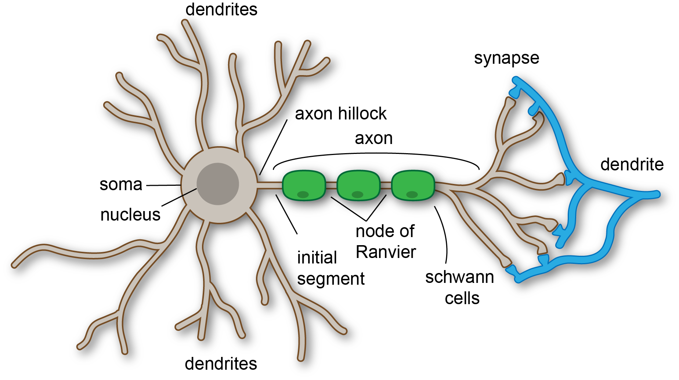
Neural Network
NN of 5-8 layer required to accurately
predict the activity of a single neuron (link)
A NN is inspired by the way the human brain processes information

Slide 8
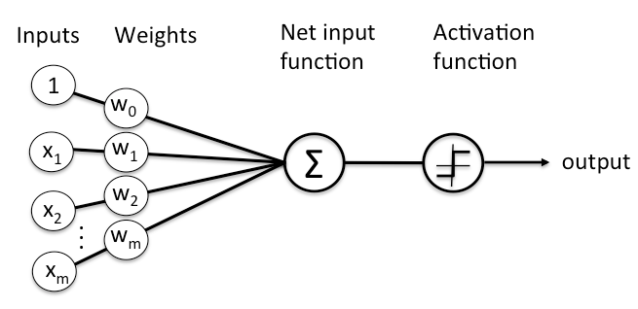
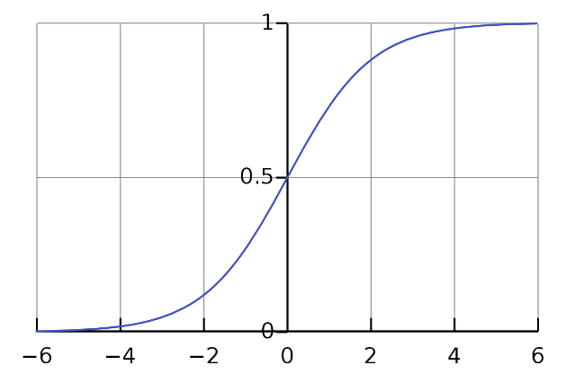
Perceptron
bias b
h(x)
Cost function J()
dot
product
label
one data
sample
theta’s
sigmoid
Bias:
Allows the perceptron to make adjustments to its output independently of the inputs
Gives the possibility to train the model over points even if all inputs are zero.
Prevents overfitting and underfitting

Slide 9
Neural Networks
Input
layer
Hidden
layer
Output
layer

Slide 10
Neural Networks
Class:
=1
=0
Input
layer
Hidden
layer
Output
layer
Notes:
Neural nets need numbers, red = 1, pink = -1 or 0

Slide 11
Neural Networks (forward)
2
½
-1
½
1
1
-2
1
-¼
Input
layer
Hidden
layer
Output
layer
Notes:
Randomly assing numers to the neural network so that you can do calculations

Slide 12
Neural Networks
2
½
2
-1
2
½
1
1
4
4
-2
1
-¼
Input
layer
Hidden
layers
Output
layer
Notes:
Insert an input can be structured data or unstructured data like an image both x and y axis are features and you want to predict the class

Slide 13
Neural Networks
(2×2) + (4×-1)
0
2
½
2
-1
2
½
1
1
4
4
-2
1
-¼
Input
layer
Hidden
layer
Output
layer

Slide 14
Neural Networks (forward)
0
2
½
2
-1
2
½
5
1
1
4
4
-2
1
-¼
Input
layer
Hidden
layer
Output
layer

Slide 15
Neural Networks (forward)
0
2
½
2
-1
2
½
5
1
1
4
4
-2
1
-¼
-5
Input
layer
Hidden
layer
Output
layer

Slide 16
Neural Networks (forward)
0
2
½
2
-1
2
½
5
1
0
1
4
4
-2
1
-¼
-5
Input
layer
Hidden
layer
Output
layer

Slide 17
Neural Networks (forward)
0
2
½
2
-1
2
½
5
1
0
≠ 1
1
4
4
-2
1
-¼
-5
Input
layer
Hidden
layer
Output
layer
Notes:
(0 x ½) + (5 x 1) + (1 x-5)
Forward propagation

Slide 18
Neural Networks (backward)
0
2
½
2
-1
2
½
5
1.2
1
1
4
4
-2
1
-¼
-5
Input
layer
Hidden
layer
Output
layer
Notes:
(0 x ½) + (5 x 1.2) + (1 x-5)
Backward propagation

Slide 19
Neural Networks
Binary classification
Input
layer
Hidden
layers
Output
layer

Slide 20
Neural Networks
Multiclass classification
Input
layer
Hidden
layers
Output
layer

Slide 21
Neural Networks
Hyperparameters
Full architecture
Hidden layers, neurons per layer
Activation functions
Learning rate
Notes:
State of the art in the hunderds of millions of params. Sometimes literally more than 1 BILLION.

Slide 22
Types of NNs
Fully connected neural networks
Convolutional neural networks
Residual neural networks
Recurrent neural networks, Long-short-term neural networks, Gated recurrent neural networks
Transformers

Slide 23
Cat or Dog
What are your rules for identifying the difference between the two images?
Image 1
Image 2
Image 3
Image 4
Revised rules for identifying images of cats and dogs
Notes:
Source: What is machine learning? | Apps For Good

Slide 24
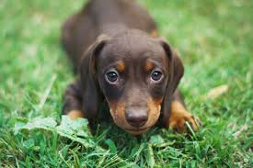
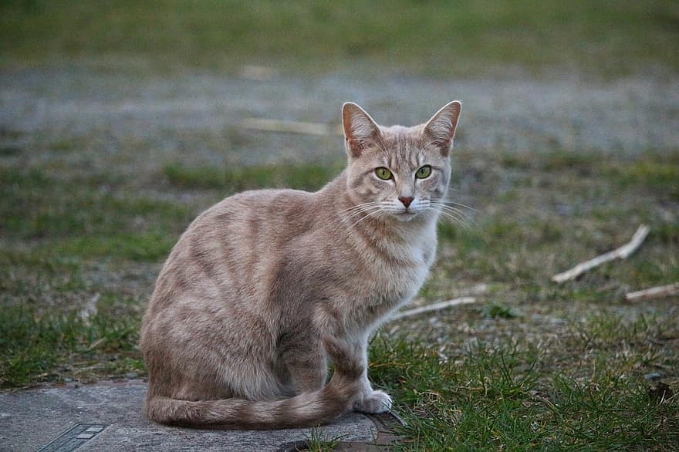

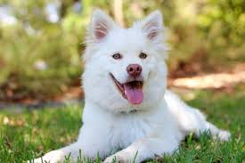
Test your rules on these four images. Do they work? If not why not? Can you improve your rules so they work for these images? Record your answers on worksheet 1.3.
1
2
3
4
Notes:
Source: What is machine learning? | Apps For Good

Slide 25
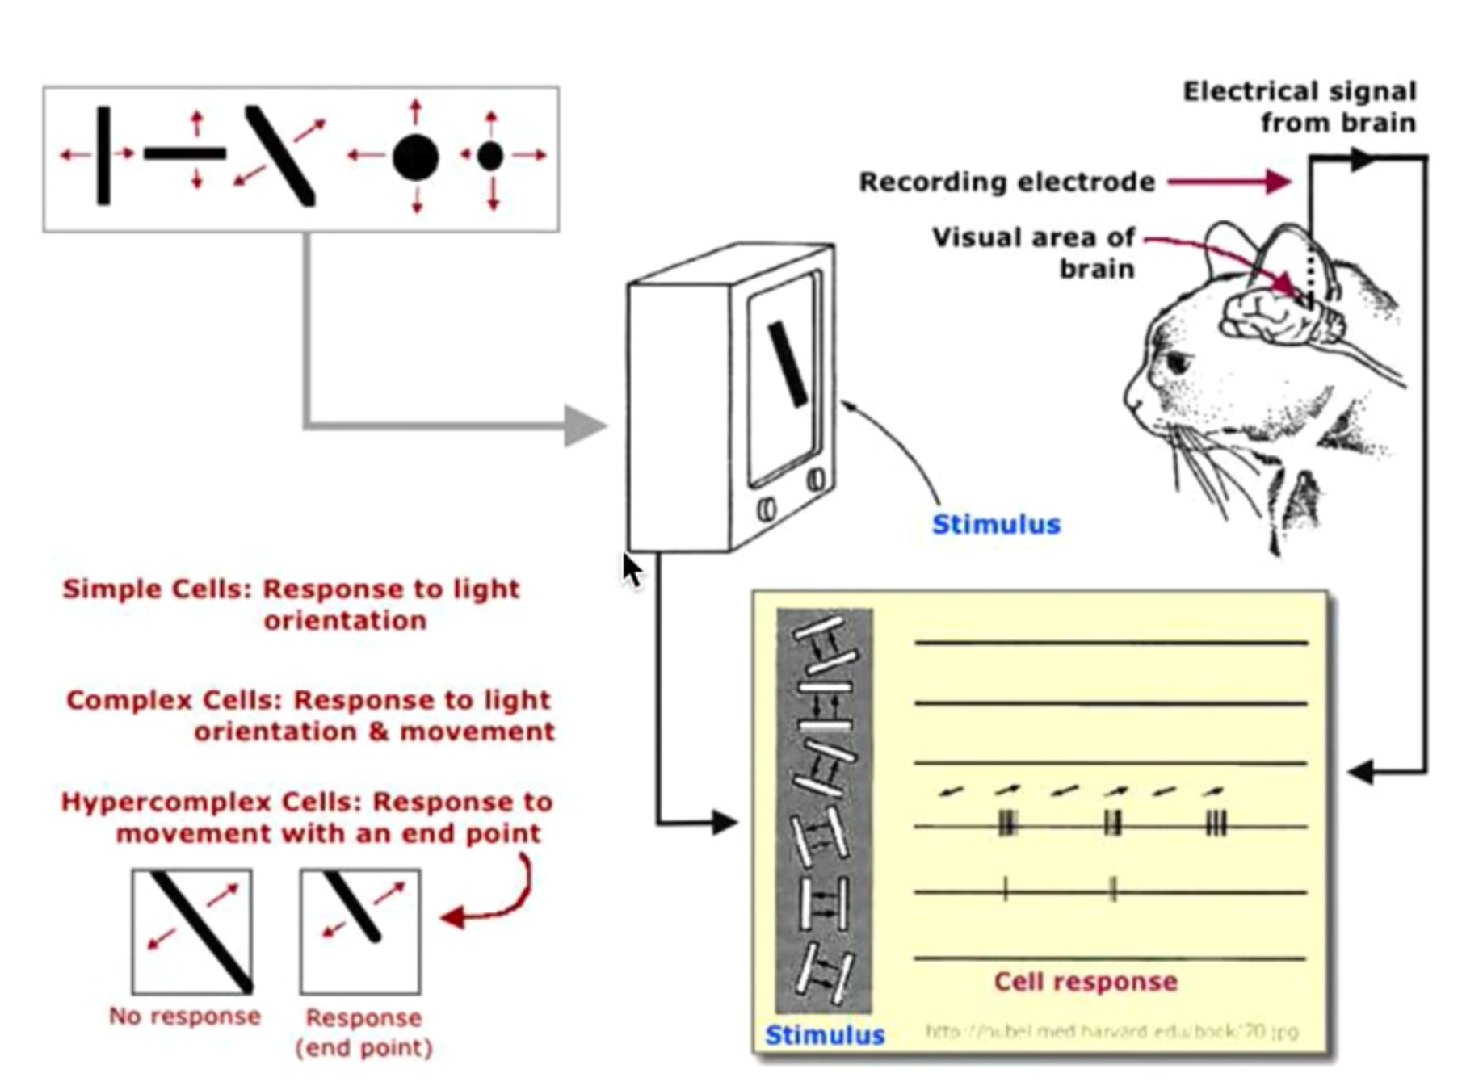
Receptive fields in the visual cortex
Notes:
During the 1960s, neurophysiologists David Hubel and Torsten Wiesel conducted a series of experiments to investigate the properties of the visual cortices of animals. In one of the most notable experiments, they measured the electrical responses from a cat’s brain while stimulating it with simple patterns on a television screen. What they found was that neurons in the early visual cortex are organized in a hierarchical fashion, where the first cells connected to the cat’s retinas are responsible for detecting simple patterns like edges and bars, followed by later layers responding to more complex patterns by combining the earlier neuronal activities. In this way the cat was able to recognize patterns in images.
Source: https://ml4a.github.io/ml4a/convnets/

Slide 26
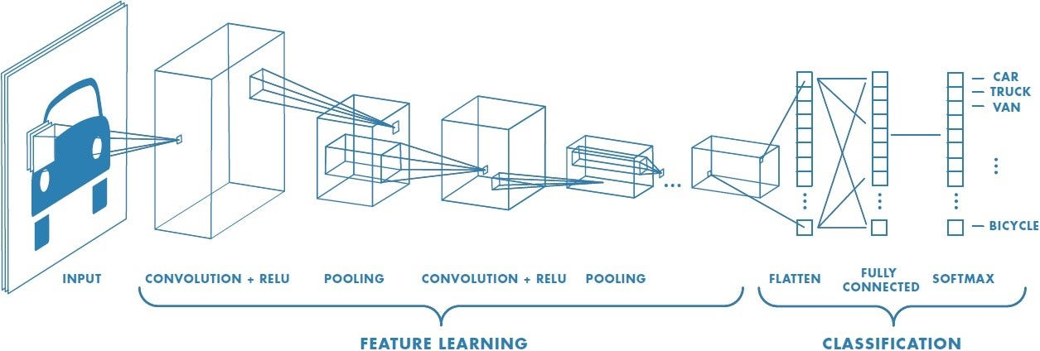
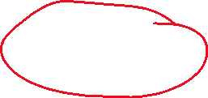
Convolutional Neural Networks

Slide 27

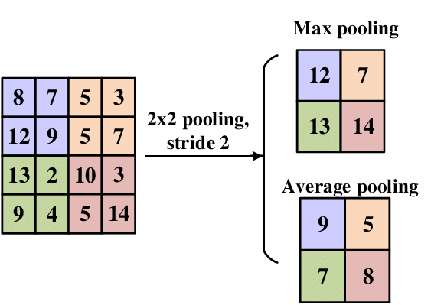
Convolutional and Pooling

Slide 28
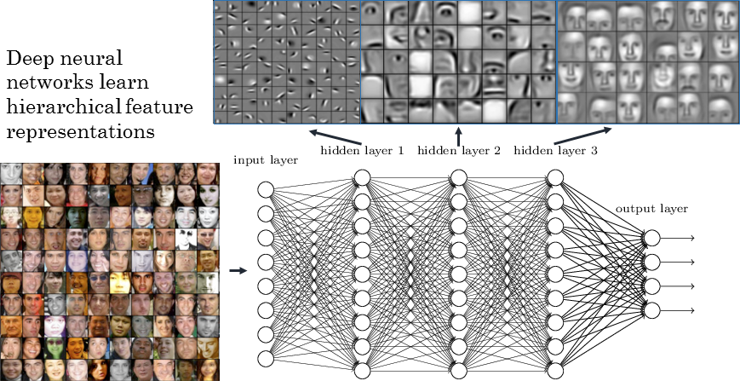
Convolutional NN (CNN)
CNN learns the relevant features needed to recognize objects in the training set
Every layer discovers bigger structures in the image

Slide 29
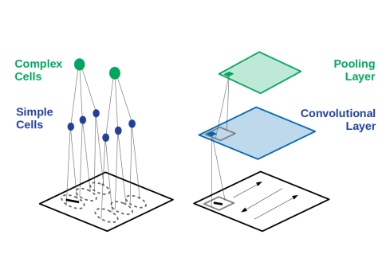
Receptive fields vs CNN’s
Notes:
Source: https://arxiv.org/ftp/arxiv/papers/2001/2001.07092.pdf

